Slide 1


Campus Synergy
Team No: 02
Team Name: Synergy Linkers
Presented By
N. AJAY KUMAR -23R21A05D0
CH. SAI SWETHA -23E21A05D7
K. PRAVALLIKA -23R21A05F8
K. LOKANSH REDDY -23R21A05F9
K. SAI VARDHAN -23R21A05G1
IoT Hackathon 2019

Slide 2
Problem Statement
In the college community, club information and communication are fragmented, making it challenging for students to stay informed and engaged.
Inefficient Communication on Campus persists as students struggle to access updates due to scattered sources.
This fragmentation leads to missed opportunities and a sense of disconnection within the campus community.
IoT Hackathon 2019

Slide 3
Customer Survey
To comprehend the significance of the problem and its impact, we conducted offline surveys within the college community.
Testimonial 1: "As a club member, we struggle to reach students for events. A centralized platform would make a significant difference.“
Testimonial 2: "I missed out on several exciting club events because the information was scattered. A solution is much needed."
Through these surveys and conversations, we have validated the pressing need for a centralized platform to address these issues.
IoT Hackathon 2019

Slide 4
Existing Solutions
The existing solutions for addressing the challenges in club communication and event promotion in the college community include:
Social Media Handles
Classroom Announcements
Sharing In WhatsApp Groups
Problems with Existing Solutions:
Existing solutions fall short due to fragmented communication across multiple social media handles, hindering user experience. Promotion challenges persist as club members rely on time-consuming classroom visits. Additionally, scattered event content across various platforms makes it challenging for users to access past event details.
IoT Hackathon 2019

Slide 5
Our Solution
Our solution, the College Connect Platform, addresses the pain points identified during our customer survey. We have cross-checked these points with customers to ensure our solution aligns with their needs and concerns
key Points of the Solution:
Centralized Communication: The platform consolidates club information, event updates, and promotional content into one user-friendly hub. This simplifies communication for users, eliminating the need to check multiple sources.
Efficient Promotion Tools: To solve the issue of time-consuming and less effective promotion, the platform offers tools that streamline event promotion. This enables club members to reach a wider audience more efficiently.
Archived Event Content: Our solution includes a feature for archiving past event content, making it easy for users to access and relive details and experiences from previous events.
IoT Hackathon 2019

Slide 6
Value Proposition
Our solution, the College Connect Platform, is more appealing to customers than existing solutions due to its Feasibility,
Centralization: We provide one place for club info, events, and promotions, eliminating the need to check multiple sources.
Efficient Promotion: Tools simplify event promotion, saving time and reaching a wider audience.
Attractiveness:
User-Friendly: Our intuitive interface enhances the user experience.
Archived Event Content: The feature allows users to revisit past event details and experiences.
Our solution meets customer needs by addressing fragmented communication and promotion challenges, making it a comprehensive solution that enhances the college experience.

Slide 7
Customers & Consumers
Consumers:
College students and club members who seek information on club activities, events, and updates.
Event organizers and promotion teams looking for efficient ways to reach a wider audience within the college community.
Customer Segments:
Student Organizations: Various clubs, groups, and organizations within the college.
Student Government: The student government body responsible for managing and enhancing the college experience.
College Administrators: Those overseeing campus communication and engagement.
Individual Students: Any college student interested in staying informed and engaged.
IoT Hackathon 2019

Slide 8
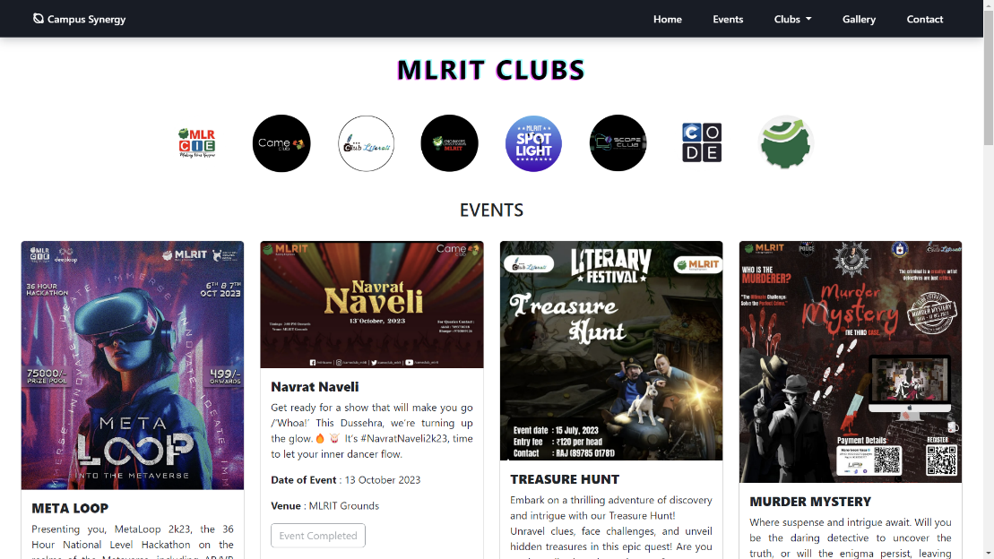
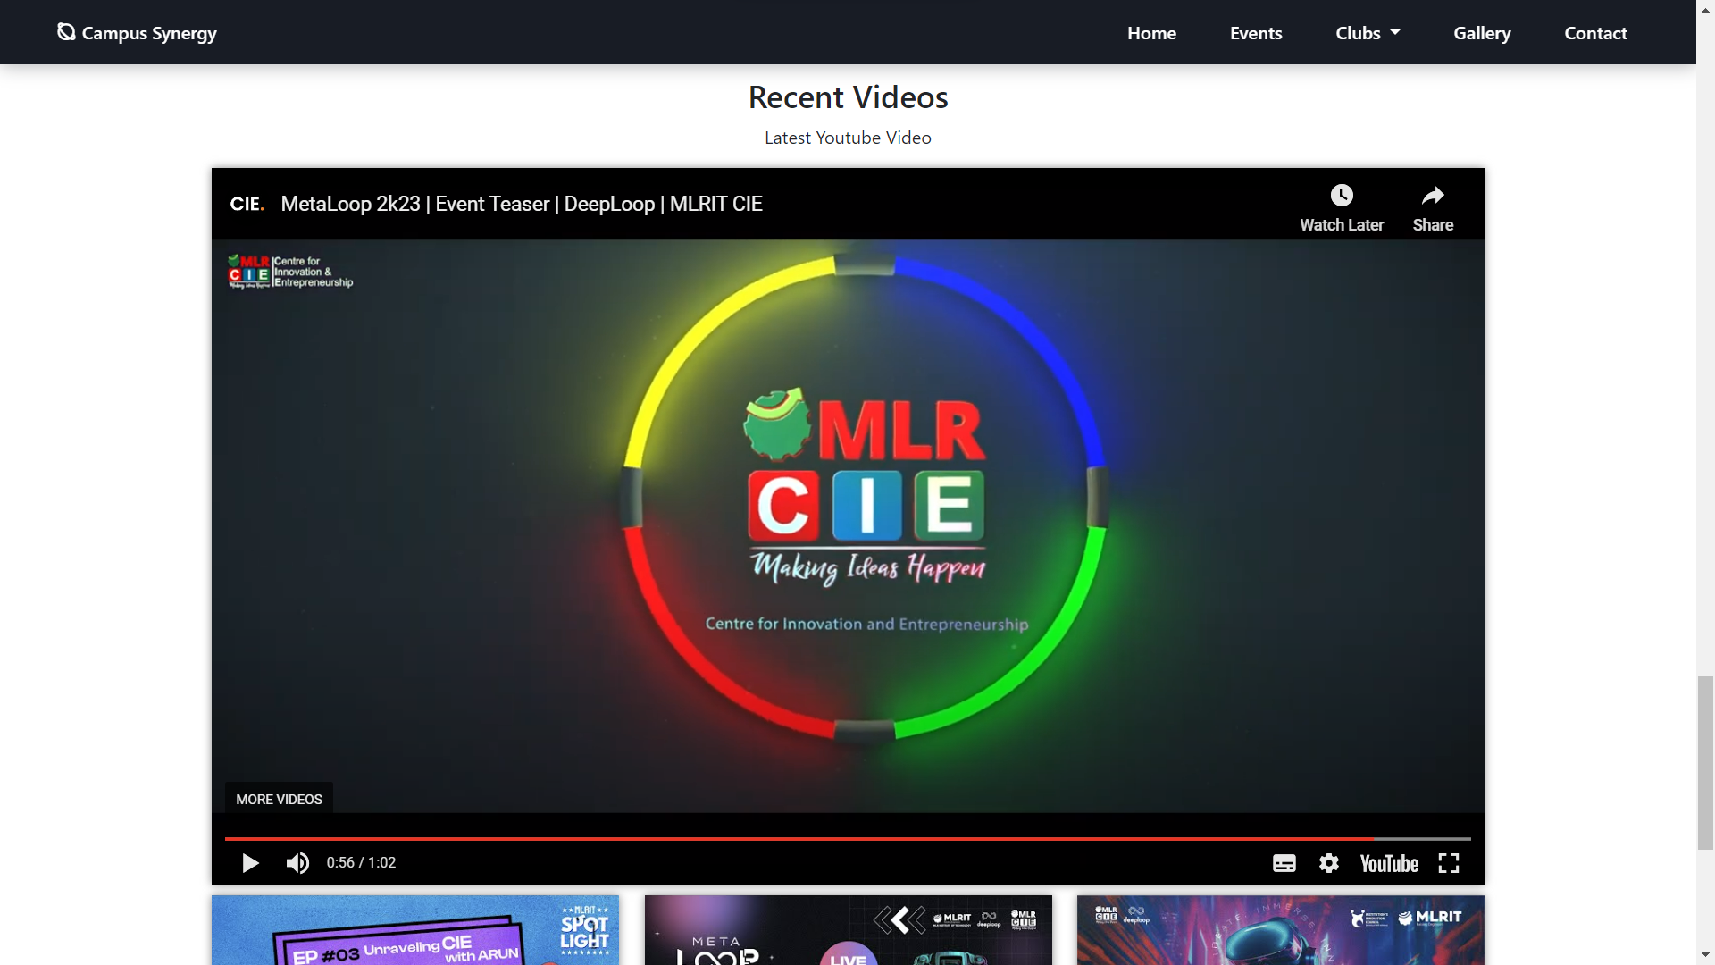
Output – Screen Shots
IoT Hackathon 2019

Slide 9
Thank You!
IoT Hackathon 2019

